Slide 1
Dynamic wake turbulence separation Saulo da Silva
SIP/ASBU/2012-WP/14
Workshop on preparations for ANConf/12 − ASBU methodology
(Bangkok, 14-18/Nadi, 21-25 May 2012)

Slide 2
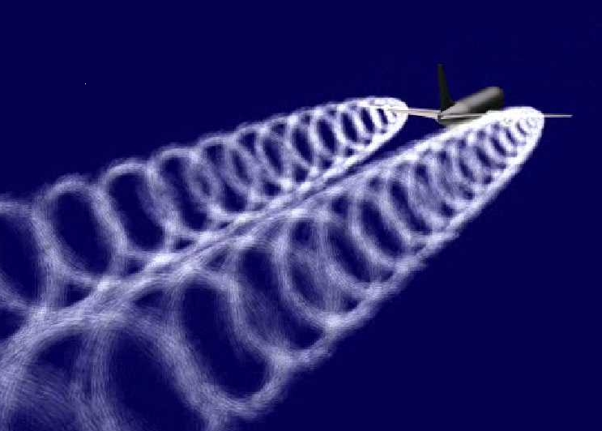
Objective
Discuss improvements in the throughput on departure and arrival runways through the dynamic management of wake turbulence separation minima.

Slide 3
Overview
What is
Plans and trials
Benefits
The key

Slide 4
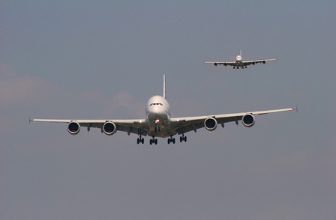
What is?
Separation dynamically assessed for each aircraft pairing and provided to ANSP tools and the flight deck for cooperative separation

Slide 5
What is?
Will optimize the inter-operation wait time to the minimum required for wake disassociation and runway occupancy
Runway throughput is increased as a result

Slide 6
What is?
Uses the current winds, assigned speeds, and real time environmental conditions to dynamically assess the proper spacing between the aircraft to achieve wake separation
Coupled with information on expected runway occupancy establishes a time spacing that provides a safe separation

Slide 7
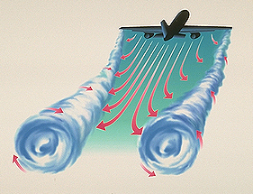
What is?
Time-based separations provided with support tools to the ANSP on their displays, and to the flight deck in the instances of cooperative separation which assumes already available flight deck tools for interval management.

Slide 8
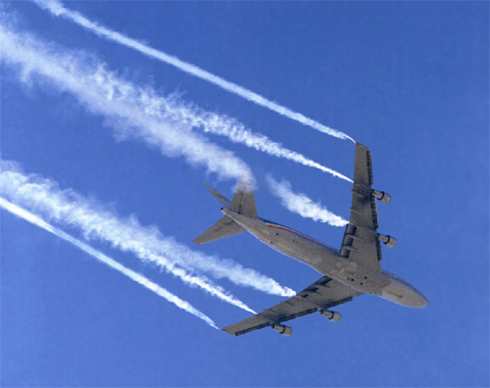
Plans and trials
Work is continuing on developing crosswind based wake separation procedures and technology upgrades for arrival operations
Human-in-the-loop simulations using the procedures and the associated controller display support
Wake Turbulence Mitigation for Departures
(WTMD).

Slide 9
Benefits
Capacity
Efficiency
Environment
Predictability
Safety

Slide 10
The key
Procedures will need automation support in providing the required time-based aircraft-to-aircraft wake separations to its air traffic controllers and pilots.

